Slide 1

SDG 11 — SUSTAINABLE CITIES & COMMUNITIES
Route Zero
Quantum-Inspired
Waste Collection
Route Optimization
"Reduce emissions. Eliminate waste. Optimize everything."
TEAM CODE CARTEL

Slide 2

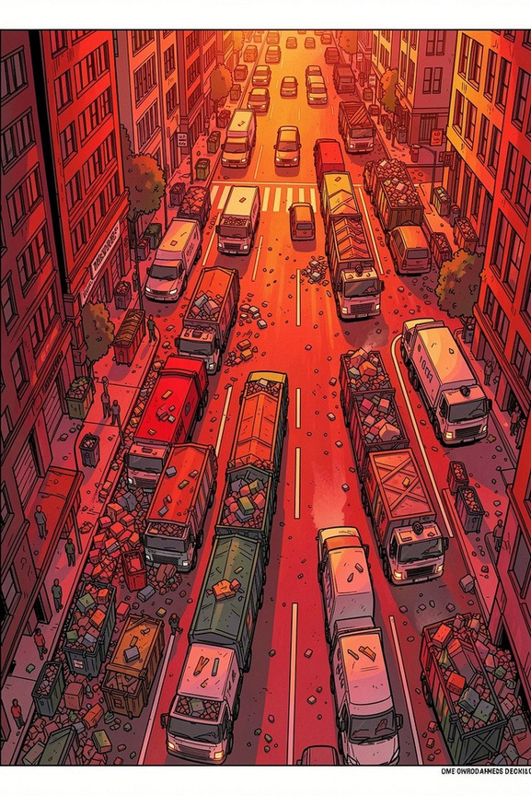
The Urban Waste Crisis
Wasted Fuel
Overflowing Bins
Fixed routes burn 30–40%
more fuel than necessary — trucks collect half-empty bins on rigid schedules.
Static schedules ignore real- time conditions, causing citizen complaints and urban health hazards.
CO₂ Emissions
Waste fleets aremajorurban emission sources. Growing cities make optimization harder.
$200B+ spent annually on waste management globally — yet routing remains stuck in the past.

Slide 3



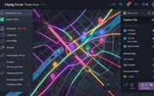
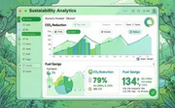
OUR SOLUTION
Introducing Route Zero
A real-time quantum-inspired routing engine for smart municipal waste systems — replacing fixed schedules with intelligent, adaptive collection.
Quantum-Inspired Optimization
Smart Bin Intelligence
Live Route Visualization
Sustainability Analytics
IoT-enabled fill-level monitoring dynamically triggers collections only when needed.
Real-time fuel savings, CO₂ reduction, and operational efficiency tracking.
and quantum
Interactive dashboard with optimized truck dispatch routes in real time.
QUBO
simulated
annealing for highly efficient route calculation.
modeling

Slide 4

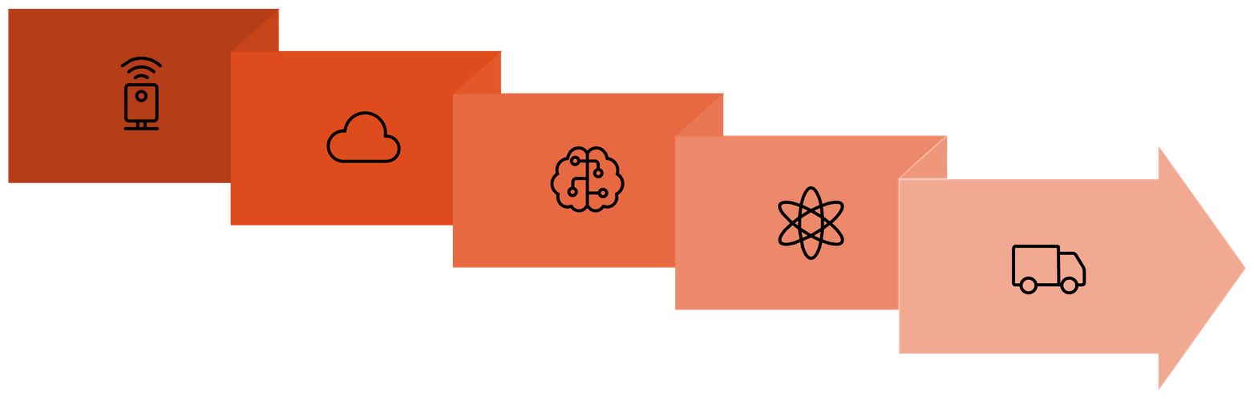
SYSTEM ARCHITECTURE
How It Works
IoT Bin Sensors
QUBO Conversion
Dispatch & Monitor
Cloud Processing
Quantum Annealing
From sensor to street in seconds — Route Zero's pipeline transforms raw bin data into optimized collection routes using quantum-inspired computation, all deployed on standard cloud infrastructure.

Slide 5

Why Quantum-Inspired Optimization?
Traditionalroute optimizationstrugglesatcityscale— theVehicle
Classical Routing
Routing Problem (VRP) is NP-hard. Route Zero uses QUBO modeling and simulated quantum annealing to generate highly efficient routes
with lower computational complexity.
210 km total route distance
Fallback modes: Simulated Annealing · Hybrid Classical Optimization · D-Wave Compatible Architecture
QuantaRoute
142 km total route distance
Efficiency Gain
−32.2% reduction in distance

Slide 6

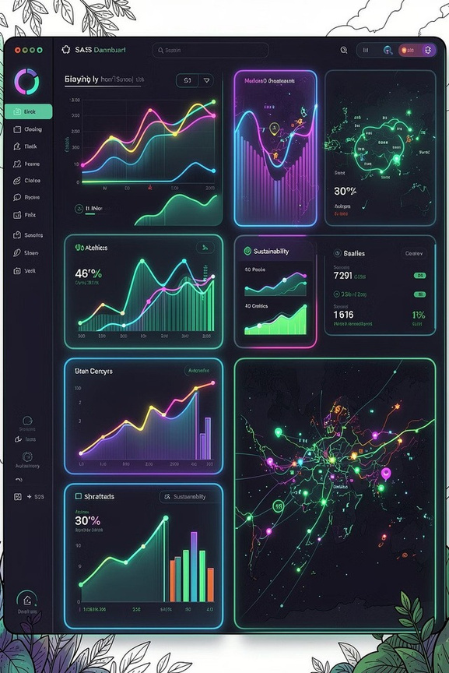
MVP DEMO
MVP in Action
Analytics Dashboard
Live City Map
12 active routes
284 L fuel saved
741 kg CO₂ reduced 89% pickup efficiency
Real-time vehicle tracking Smart bin heatmap overlay Optimized route visualization
Quantum Engine
Simulated annealing convergence Optimization cycle metrics
Route scoring & comparison
Functional MVP with real-time visualization, live optimization simulation, and sustainability analytics.

Slide 7

IMPACT & SDG ALIGNMENT
Real-World Impact
🏙
SDG 11 — Sustainable Cities & Communities
741kg
284L
CO₂ Avoided Daily
Per optimized collection cycle
Per collection cycle
3.4h
89%
Fewer Missed Pickups
Collection time saved per route
Reduction in missed collections
"Route Zero transforms waste collection into intelligent urban infrastructure."
SDG 13 — CLIMATE ACTION
SDG 9 — INDUSTRY INNOVATION

Slide 8

COMPETITIVE ADVANTAGE
What Makes Route Zero Different?
Quantum-Native Architecture
Dynamic Real-Time Routing
Routes adapt based on live fill- level intelligence instead of rigid fixed schedules.
Hybrid Deployment Ready
Runs today on classical infrastructure while remaining fully quantum-ready for tomorrow.
Built specifically for QUBO
optimization and future quantum hardware deployment — not an afterthought.
Why Now? Cloud quantum platforms like D-Wave Leap and IBM Quantum are making quantum-inspired optimization accessible — without requiring physical quantum hardware.

Slide 9

ROADMAP
Built for Scale
Phase 1 — MVP (0–3 Months)
1
Smart bin simulator Optimization engine FastAPI backend Dashboard prototype
2
Phase 2 — Smart City Pilot (3–9 Months)
IoT sensor integration Multi-zone routing
ML demand forecasting Driver mobile app
Phase 3 — Enterprise (9–18 Months)
3
SaaS licensing
Government integration Carbon credit analytics Large-scale deployment APIs
MVP Deliverable: Working web platform with live route optimization, sustainability tracking, and quantum-inspired intelligence.

Slide 10

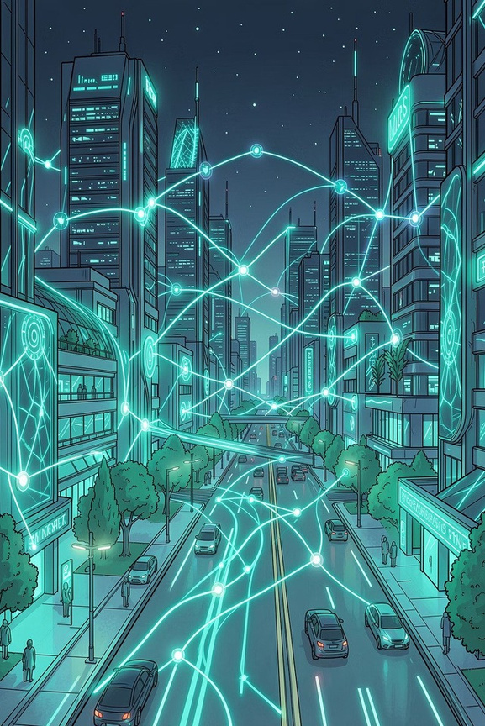
Every Optimized Route is One Less Truck-Kilometer of CO₂
Route Zero is not just a routing platform — it is next-generation smart city infrastructure.
Quantum Intelligence for Cleaner Cities
Dhiraj G
Full Stack Developer
Abhi
Backend & Optimization
Dhruva
UI/UX & Frontend
Durgesh
Research & Presentation
SDG 11 — SUSTAINABLE CITIES & COMMUNITIES
TEAM CODE CARTEL
23/05/2026

